Slide 1
AUTOMATING THE ATM RECONCILIATION PROCESS IN BRANCHES

Slide 2



GitHub Links to files and Sripts
VBA Excel-based implementation
Python-based implementation
Flowchart for python-based implementation
Sample output workbook

Slide 3
BACKGROUND
The ATM reconciliation process (RECON), is used to reconcile all transactions on the bank’s Automated Teller Machines (ATM) daily. This process is carried out every day by the branch managers (BM) managing these ATMs.
This process to ensure that:
All daily transactions on the general ledger (GL) of these ATMs completely match the transactions of the machine’s electronic transactions page (FEP),
The cash unloaded is not more or less than expected, and
Identify dispense errors

Slide 4
PROBLEM STATEMENT
RECON is carried out manually by the branch managers or their assistants daily and takes an average of thirty minutes to conclude it for an ATM.
Branches an average of seven (7) ATMs within their custody which must be reconciled daily if transactions take place on them. This process is carried out in over 600 branches of the bank.
This is equivalent to 3 hours 30 minutes spent on reconciliation by each branch.
Most branches of the bank are inadequately staffed, and this results in pressure on staff to deliver this report while keeping up with the other operational functions.
Also, as with every manual process, this report is subject to errors due to its complexity.

Slide 5
PROPOSAL
To automate the RECON of ATMs and the generation of the report.
To achieve a reduction in time taken from 30 minutes to 30 seconds for each ATM, which is equivalent to 98.3% improvement on the current process.
To eliminate human error in the process by limiting(or eliminating) manual processes.

Slide 6

Methodology
The project is in two stages:
Stage 1 (Excel and VBA-Based Design)
This stage involves the use of excel VBA built on the existing template in order to fully automate all the activities of the reconciliation process.
All activities involving spooling of data, copying, pasting, formulas evaluation, formatting and comparison are handled by macros written.
A user form is built on the excel to allow the users to supply input information such as previous load amount, most recent load and unload amounts, times of previous load and recent load, ATM ID and branch code.
Upon entering the input information and selecting submit, the report is automatically generated and saved in a directory on the computer.
This can be accessed from Github link

Slide 7
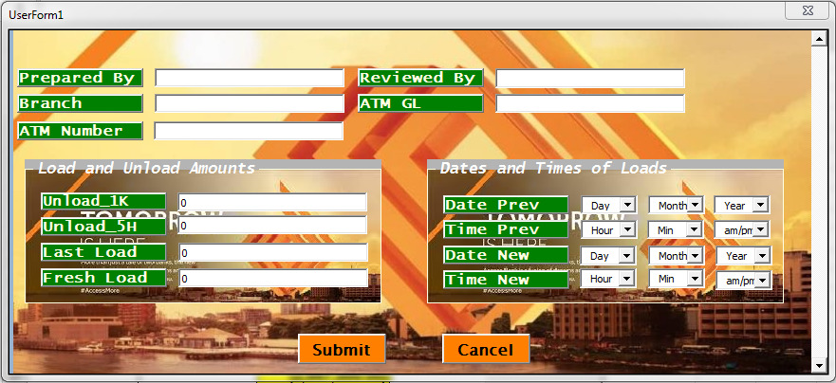
USERFORM for Data Entry

Slide 8
Methodology (Continued)
Stage 2 (Python-Based Design)
This stage involves the deployment of the process on the web for portability.
All procedural and logical activities highlighted in stage 1 are carried out using Python
A front-end web developer will then create a webpage for user interaction.
The development and simulation is carried out in Jupyter Notebook.
The report is automatically available for download after the input information has been entered and submitted.
The python script can be viewed on GitHub

Slide 9
VALUE PROPOSITIONS
Time Saving: This model reduces the time required to perform RECON from thirty minutes to less one minute. This means more time for branch managers to perform other tasks and close on time.
Reduction in Human Error: The model will reduce any human error that could result from manual performance of the RECON process.
More Efficient Analytics: The accurate RECON report will be made available to the various necessary stakeholders on time. They will provide management with more precise analytics.
Human Capital Saving: The bank will be saving an average of 2 hours 57 minutes of Branch Manager’s time. This time will be re-invested in other activities.

Slide 10
Sample Output
The output is an excel workbook with the following sheets:
Certificate
ATM Manual Balancing
Manual Balancing Transactions
ATM Recon
GL
FEP
Transactions after cash count before EOD
Suspected Dispense Error
On FEP not on GL
On GL not on FEP

Slide 11


Thank You

